Slide 1


Slide 2
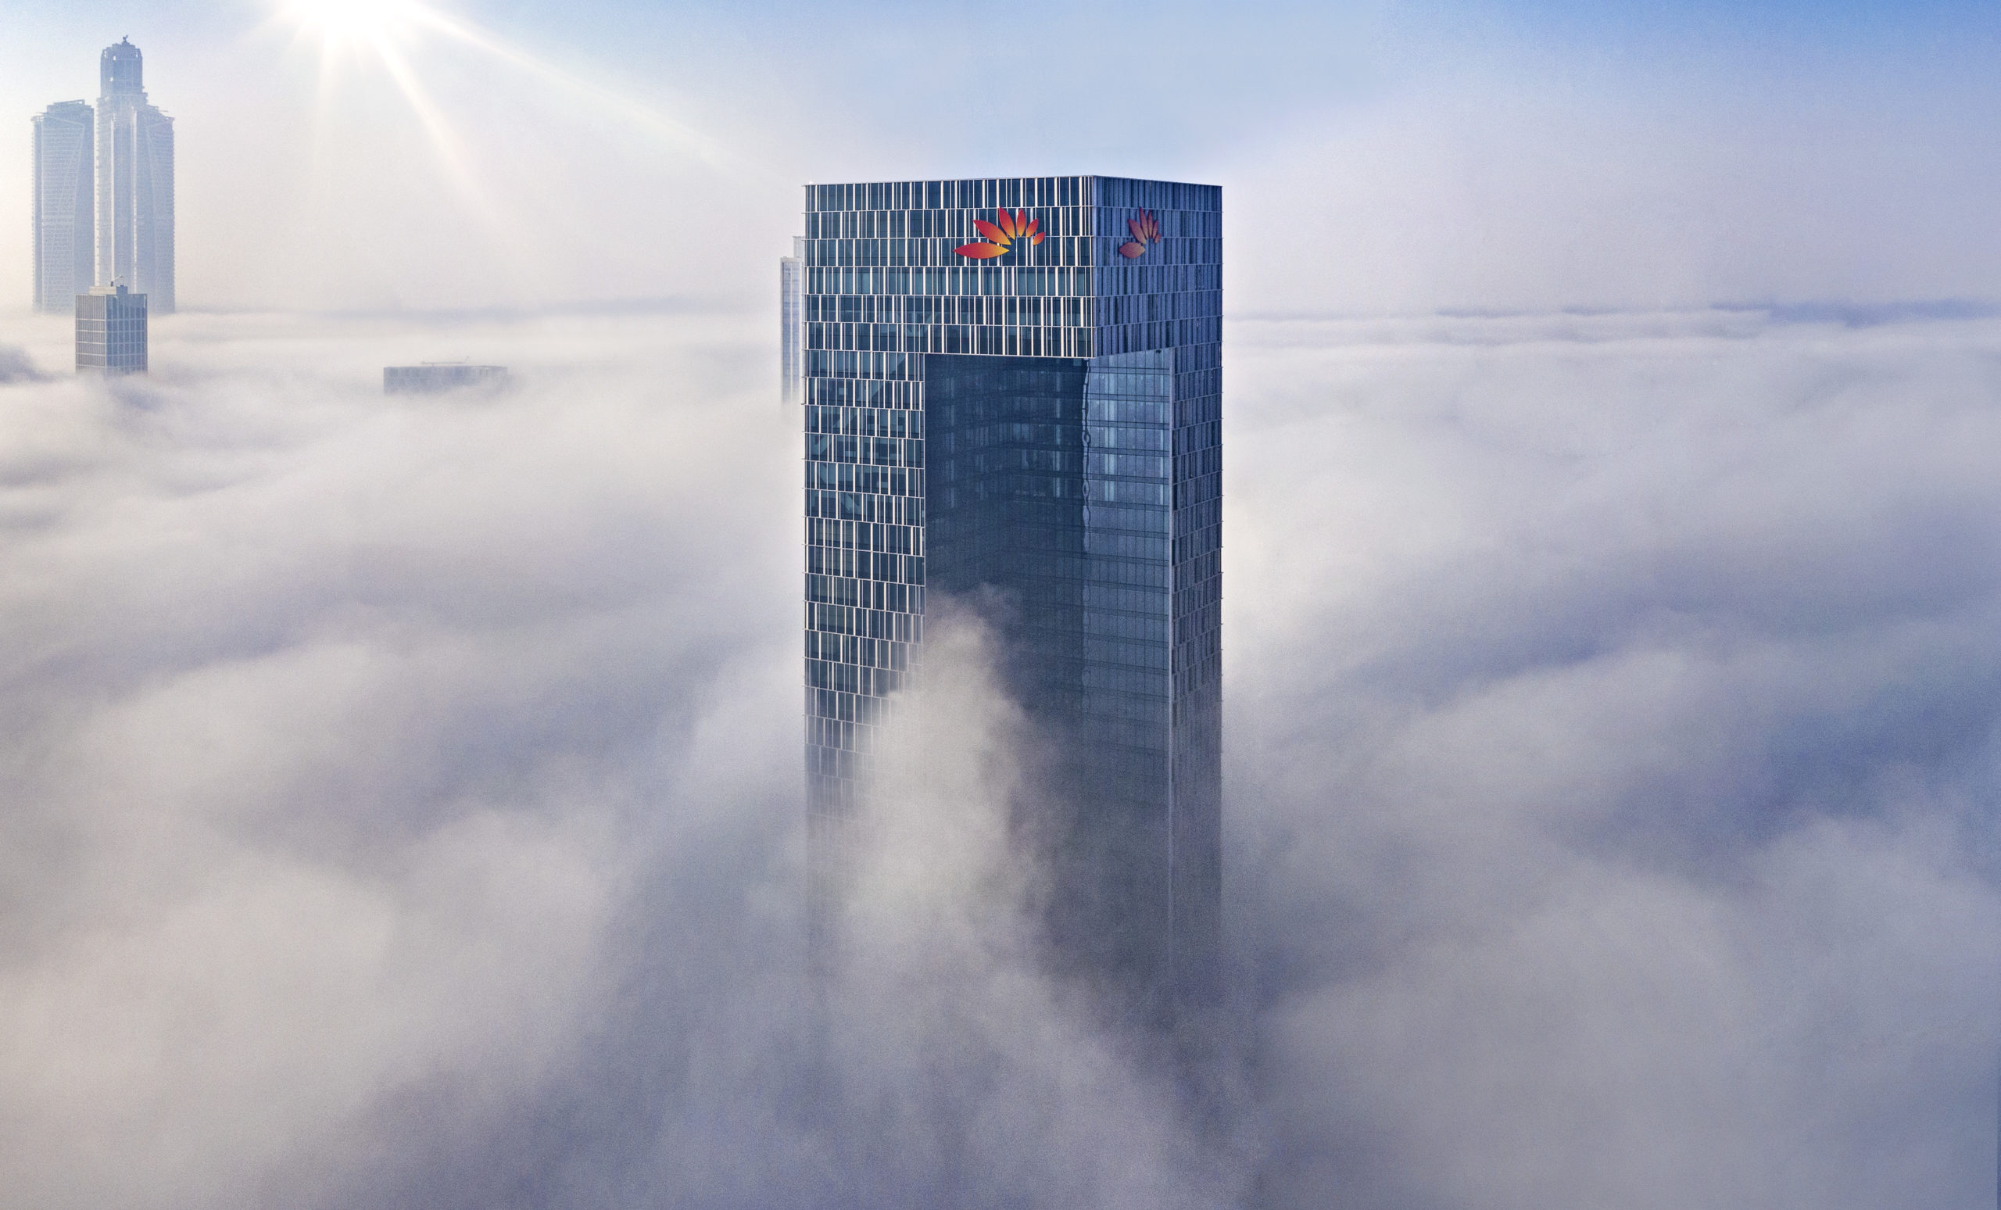
CORPORATE TECHNOLOGY
NEWSLETTER FOR Q1

Slide 3
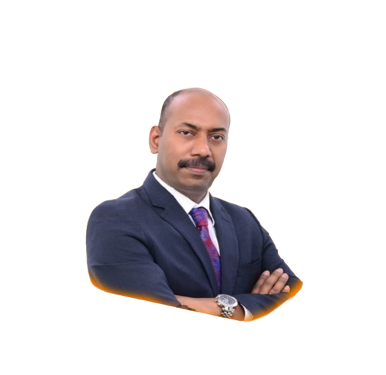


Welcome !
As the head of our Corporate Technology division, I'm thrilled to welcome you to our newsletter.
Within these digital pages, you'll find a wealth of information on the latest achievements, trends, and initiatives driving our organization forward. From groundbreaking innovations to insightful analyses, we're dedicated to keep you at the forefront of the ever-evolving Technology landscape.
Join us on this journey as we explore the exciting possibilities that technology has to offer.
Sajeev Kumar
Head of
Corporate Technology,
Enterprise Risk & Compliance Technology,
HR Technology

Slide 4




Q1 WHEEL

Slide 5

Q1 ACHIEVEMENTS
Titan trade moves closer to reality - Titan 14.7 moved to UAT.
Landing page MVP1 rolled out to the customers.
Final delivery of cash and payments under UAT, on track for June go-live.
174 Customers migrated for Cash and Payments ( Total customers in production is 289).
Collections - 97% of the customers (167) moved to production.
Egypt Collections program commenced; Central bank of Egypt approval received (Planned Go live – Nov’ 24)
Buyer Led Supply Finance (BLSF) for Egypt and Receivables finance for UAE (Planned Go live – Oct’ 24)
Real Estate and API Banking program commenced.
Trade implementation scoping study completed for US/UK/HK.
NY Trade - Tactical trade solution implemented in T24 for New York
The India Branch Movement & Virtualization was executed seamlessly
Fircosoft systems enabled for Egypt Sphynx and New propositions, Improved STP rates from 65% to 85%
Active-Active setup enabled for payment screening for 24X7 availability with zero downtime.
Q1 ACHIEVEMENTS

Slide 6
Q1 ACHIEVEMENTS
SAS AML:
VA Dashboard to view Alert Hibernation status, providing on-demand MIS for alert tracking and business auditability
Cash flow ETL code optimization to improve the AGP execution time for UAE region
Go AML Application upgrade to .NET Core for better performance, scalability, support and application resilience
Implemented the Customer Transaction Variance Analysis report for India Region - validating customer KYC information
Eagle Eye:
EE Pilot launch for CSR (Sanctions team)
Digital Banker award for outstanding achievements in AML/CTF for Eagle Eye
GenAI LLM PoC for Counter party risk assessment
PICG Digital Transformation Program:
Implementation of new Learning Management Platform
Successful completion of the Annual Increment & Bonus cycle across Bank, leveraging new platform implemented
Kick start implementation of new Recruitment & Onboarding platform.
Q1 ACHIEVEMENTS

Slide 7
Q1 FOCUS
Neo Corp
Cash & Payments 14.7 upgrade
Trade Finance 14.7 UAT closure
Egypt rollout with first set of customer migrations
Digicollect achieve 100% customer migration
Trade implementation parameterization to be completed for US/UK/HK.
IBG
HK - Launching of Bonds Module - Introduce Bonds in T24
IN - Clearing Corporation of India Ltd (CCIL) DR Set Up - Set up DR site for IBG Mumbai in MGN Bangalore
IN - Obligation Register - Develop a compliance register for the regulatory obligations
OM – Oman branch Set Up - Phase 1 SIT Completion
US - Branch Tech Refresh - Environment readiness phase
HCM Cloud re-configuration to enable co-existence with FIN functions – Build Phase
API based integration between Fusion HCM and U.A.E Central Bank Smart System – Build Phase
PICG Digital Transformation Program:
Implementation of new Recruitment & Onboarding platform – Build Phase
Digitization of ‘Rewards and Recognition’ and ‘Salary Adjustment’ process - UAT
Q1 FOCUS

Slide 8
OUR NEW TALENTS
4
"Welcome aboard, new talents! We're excited to have you join Mashreq. Get ready to make an impact and be part of our dynamic team. Let's achieve great things together!"
NEW TALENTS

Slide 9
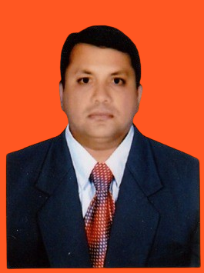
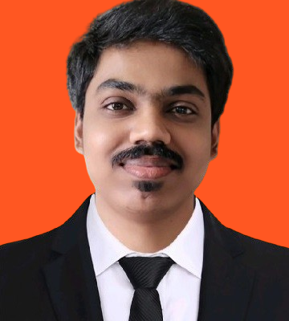
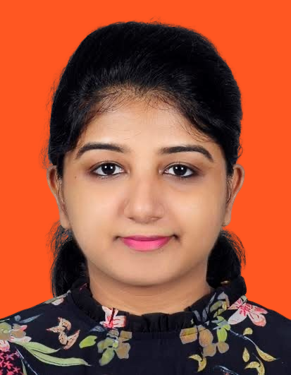
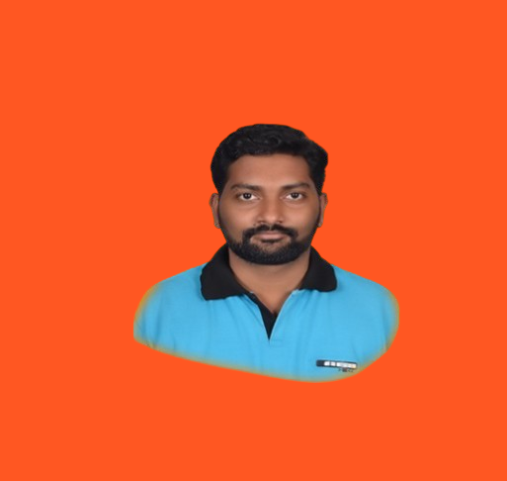
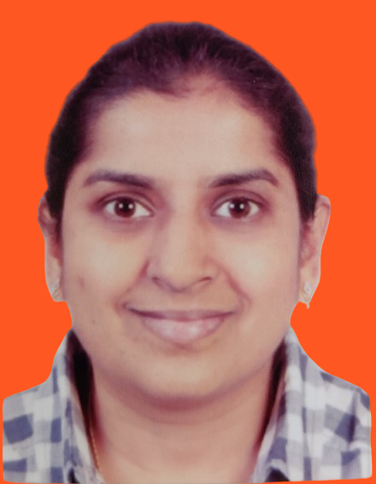
OUR NEW TALENTS
Benita Jeya Suganthy
Team: GTB
About me: I have been working in UAE region for 4 years and I have an overall experience of 8 years in Global Transactional Banking. I am passionate about travelling and exploring different cultures.
So far @ Mashreq: Mashreq has really been welcoming. It’s been a month, and I could see how process oriented and due-diligent working methodologies maximizes our efforts and brings out the best in all of us.

Slide 10
OUR NEW TALENTS
Parini Dedhia
Team: GTB
About me: I am an Engineering graduate with specialization in Computers, I started my career with mobile games and apps development and then moved in to Banking domain since Jan 2012. I have good experience in OBDX Internet and Mobile Banking implementations.
So far @ Mashreq: My journey in Mashreq is interesting as it’s the first time I am joining a company remotely. Everyone here is very knowledgeable and helpful and do not hesitate in guiding the newcomers.

Slide 11
OUR NEW TALENTS
Naveen Dangeti
Team: Compliance Technology
About me: I bring 12 years of IT experience working across Insurance, Pharma, Banking and CPG domain. Holds B.Tech degree, Post Graduate Program in Data Science. I love watching movies in big screens and very passionate about cooking.
So far @ Mashreq: I have received my laptop and welcome kit even before I join Mashreq! This made my onboarding smooth and almost all my setup done including account creation within a day. I am genuinely excited about the opportunity to collaborate with the people at Mashreq and grow together!

Slide 12
OUR NEW TALENTS
Rohan Suresh
Team: Nitro
About me: I am born and brought up in Pune, Iam frontend developer with 5+ years experience, My hobbies are watching Sci-fi movies, bike riding and I love photography.
So far @ Mashreq: People are helpful and culture is good every process is clutter free and standardized , Overall nice experience with Mashreq.

Slide 13
OUR NEW TALENTS
Sai Prasad M
Team: Tech HR Tech
About me: Around 6-year experience on Oracle fusion and my hobbies : Playing cricket and reading books.
So far @ Mashreq: I have met my manager and colleagues, and they have been giving a good support in work and it is a great way to learn a new technology. I am very thankful to Mashreq for giving me the opportunity to work with Mashreq family.

Slide 14
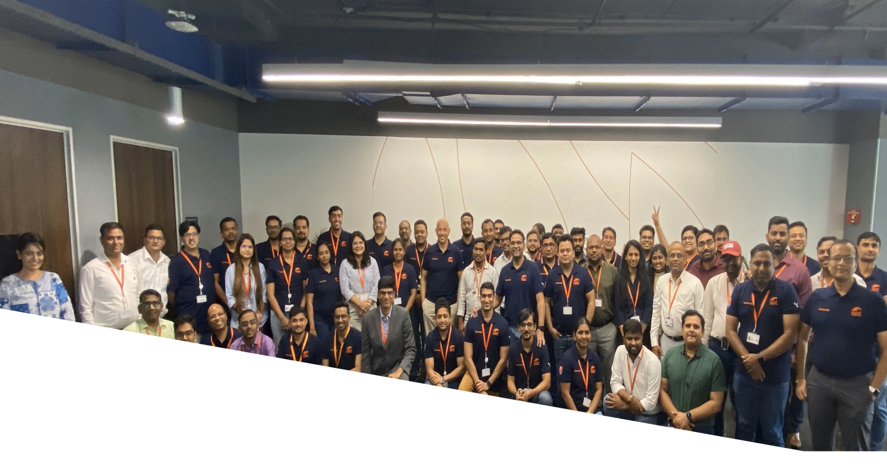

‘Clicks’ Corner`
MGN (IN) team with MO
MGN(IN) Technology team members enjoyed productive discussion with MO, reflecting our last year accomplishments, establishing the focus, priorities for this year on 13th & 14th Feb’24.
Wrapped up with a dinner hosted by MO honoring 'Top Contributors’.

Slide 15


THANK YOU.

